Slide 1
Praktikum Pemrograman Web
Azhary Arliansyah

Slide 2
What we’ve learnt so far
HTML & CSS
1
PHP
2
MySQL
3
JavaScript
4
Ajax
5
jQuery
6
PHP OOP
7
.... (now what? Klik ini jika penasaran apa yang harus dipelajari untuk menjadi web developer)
8

Slide 3
Software Engineering Aspects
4 Pillars in Object-oriented Programming
Coupling
Cohesion
Design Pattern
Testing
Documentation

Slide 4
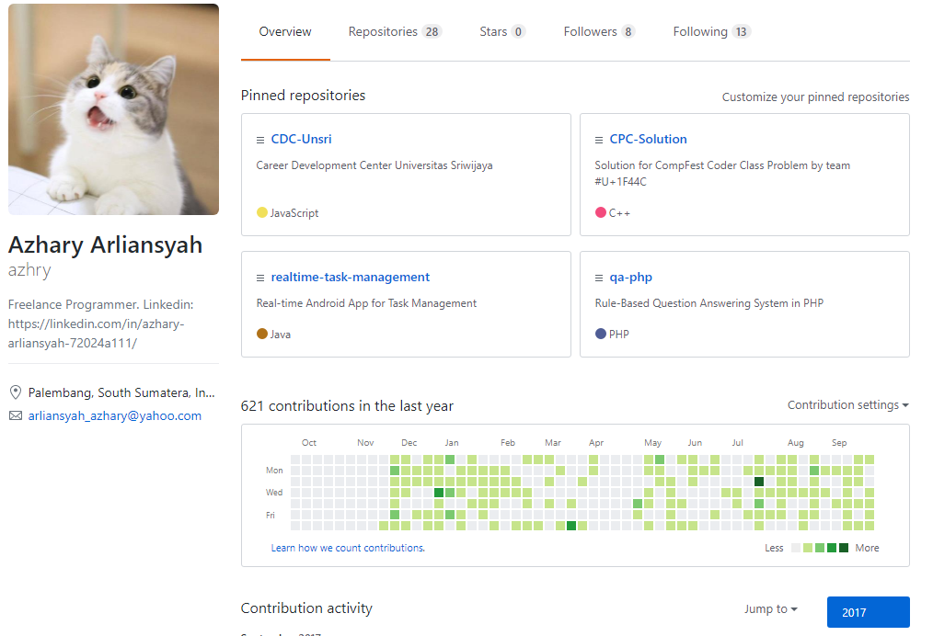
Github

Slide 5
Long Answer
API, Database, Web Hosting, Server Configuration, Networking, Security, Distributed System, Computer Hardware, Robotics, Computer Engineering, Algorithms, Data Structure, Real-time Programming, Mobile Programming, Data Communication, Artificial Intelligence, Machine Learning, Data Mining, Neural Network, Expert System, Decision Support System, Computer Vision, Natural Language Processing, Fuzzy Logic, Version Control, Information System, User Interface, User Experience, Project Management, Math, Biology, Chemistry, Physics, Social Interaction, Art, Religion, Politics, Sociology, Psychology, Teaching, Sports, Medic, Scientific Method

Slide 6
Short Answer
Learning how to learn, easy enough?

Slide 7
NO
If it is easy, then you are not special because everyone can do it

Slide 8
How?
Step 1: enough motivation, start action

